Slide 1
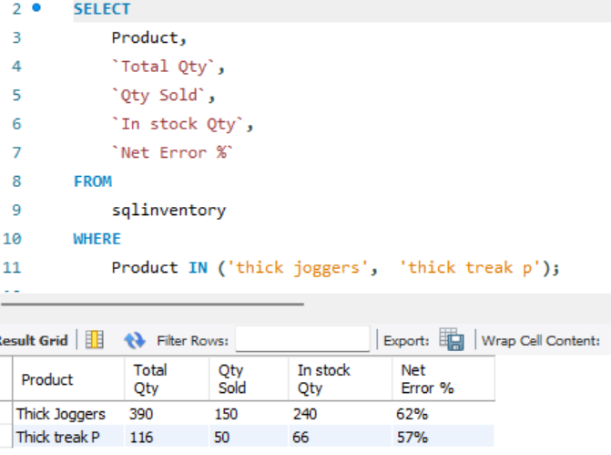
Retrieve data for "thick joggers" and "thick track pants," including their total quantity, quantity sold, in-stock quantity, and net error percentage.

Slide 2
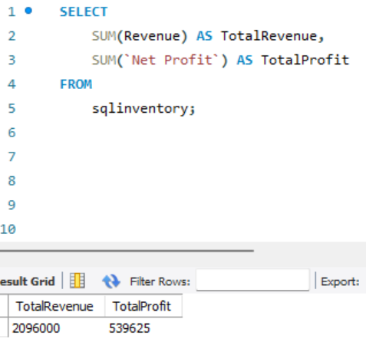
Retrieve data for total revenue, profit,

Slide 3
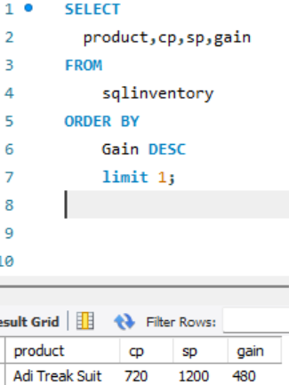
Return data for the top gain.

Slide 4
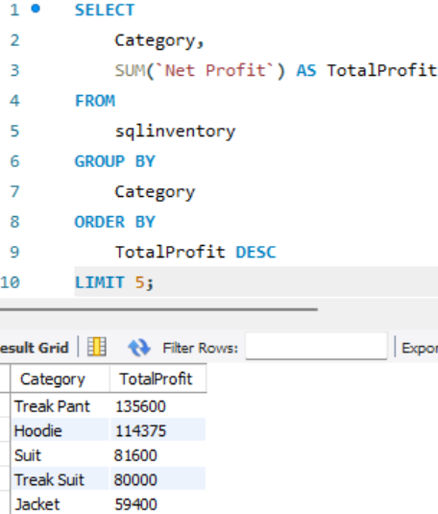
Which 5 category contributes the most to profit

Slide 5
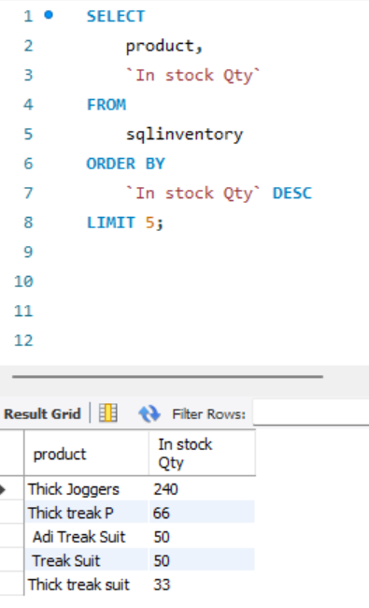
retrieve the top 5 products with the highest stock quantity

Slide 6
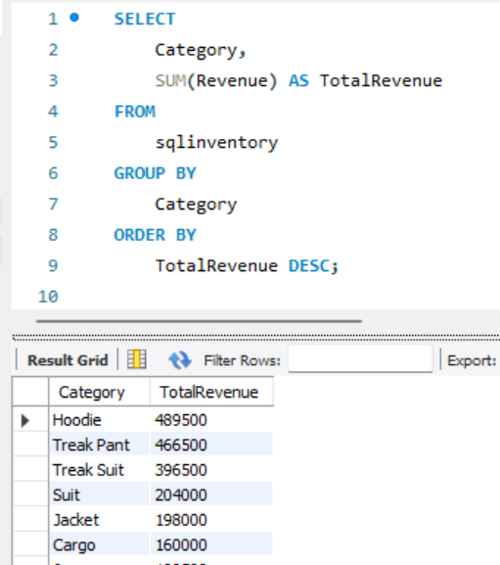
Which category contributes the most to revenue

Slide 7
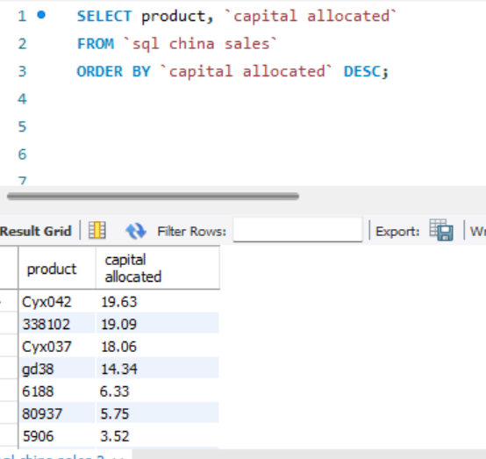
Which 7 product has highest amt of capital allocated?

Slide 8
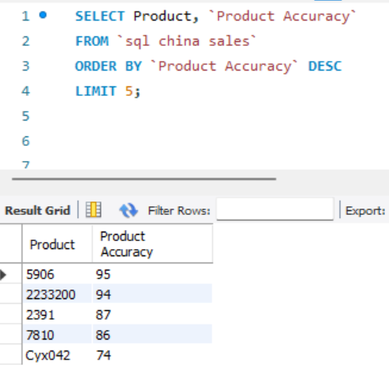
Which 5 product demonstrates high product accuracy

Slide 9
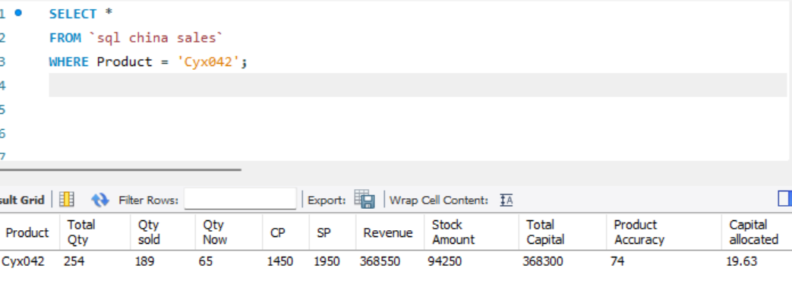
Return all data of cyx042 product

